Slide 1



NPQ for Leading Teacher Development
Autumn 2024

Slide 2

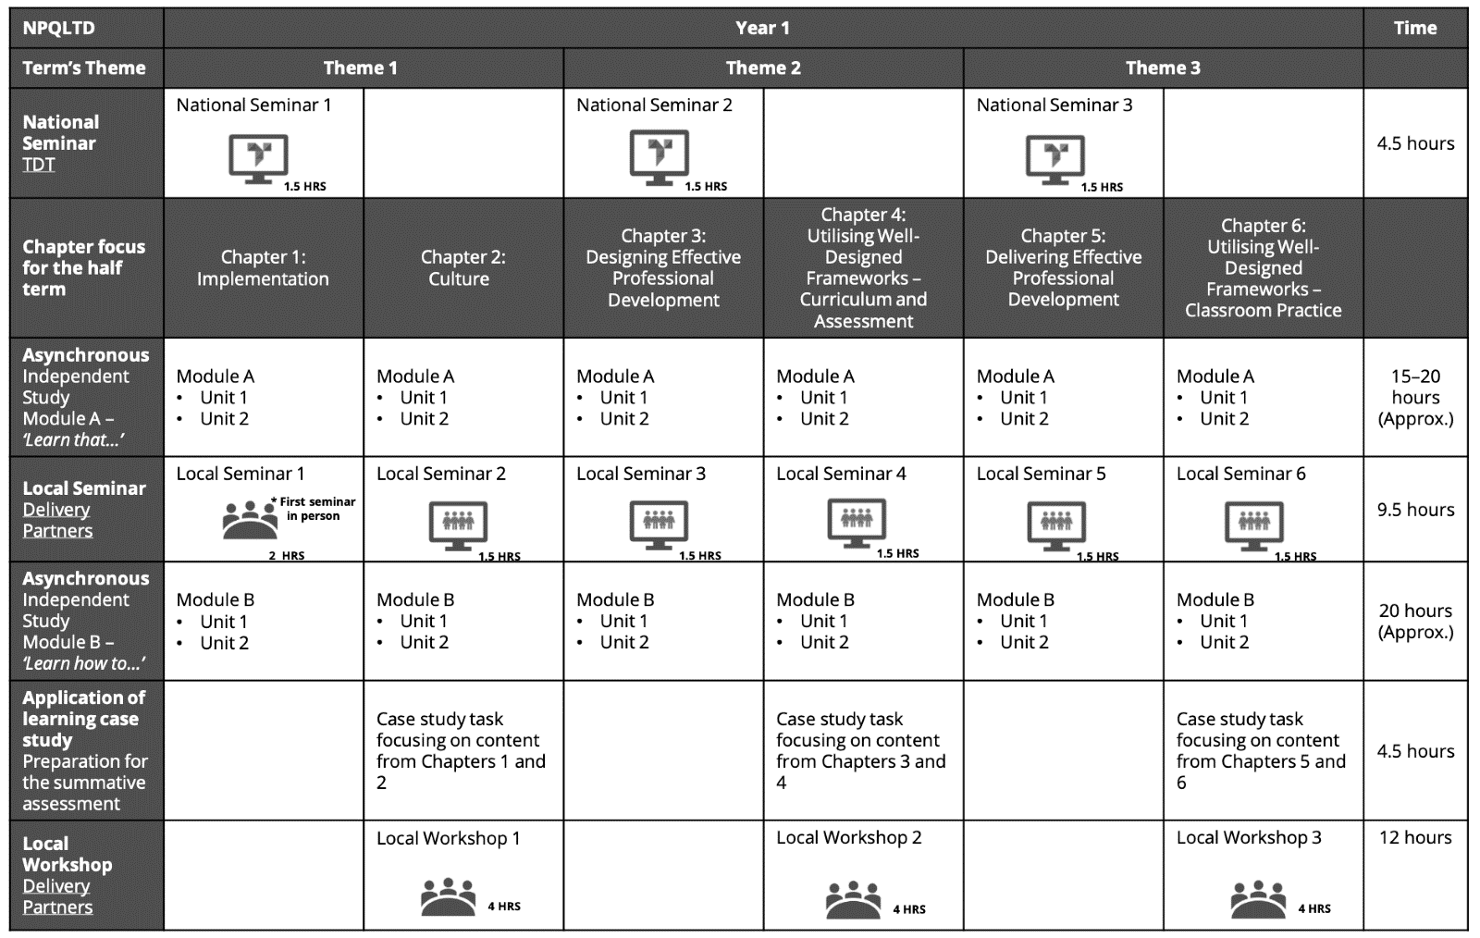
Dear Participant,
Huge congratulations on being accepted on to our NPQLTD Programme. As we know, research tells us that leadership is second only to teaching in making a difference to outcomes for young people. The programme you are embarking on will further enhance the contributions you can make to this.
The NPQLTD aims to help you to lead great quality teaching and curriculum, whether in a subject, year-group, key stage or a phase.
The aim of this letter is to help you begin to familiarise yourself with the programme and to start feeling ready for the exciting challenges and opportunities ahead of you.

Slide 3


National Professional Qualification for Leading Teacher Development (NPQLTD)
All NPQs in the suite have been carefully constructed with some key areas of learning in mind, and these are listed below:
Course structure and approach
The NPQLTD has 12 months of study followed by an assessment period.
Our flexible study approach is underpinned by high quality, web-based self-study with plenty of online discussion with your peers and support from your course leader.
You will have heard from TDT when your national online seminar is, but you will also find the information about that, and the dates and venues of all other activities listed above in the attached calendar. Key activities in these sessions will include:

Slide 4
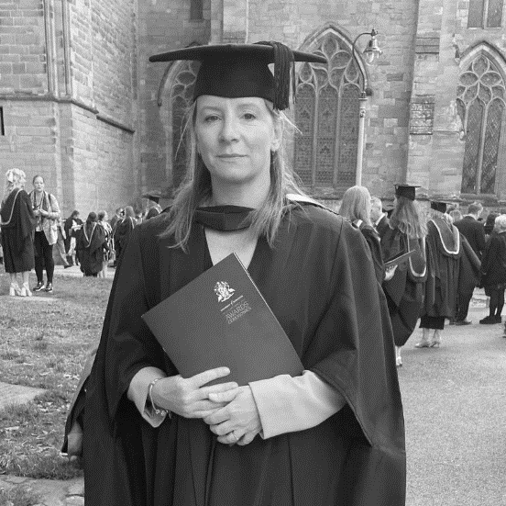

Your facilitator will be:
Andrea Taylor
Billie Stewart
Andrea is Deputy Director of Prince Henry’s Teaching School Hub. In this role, she oversees NPQ delivery across Herefordshire and Worcestershire and leads the Quality Assurance process for Prince Henry’s Appropriate Body.
Andrea has worked in education for 24 years. In this time, she has been a teacher of History, Politics and Sociology within three schools across Worcestershire. She has been a Head of Department, Specialist Leader of Education and School Direct Alliance Lead.
Andrea is a facilitator for the Early Career Framework with Ambition Institute as well as an NPQ facilitator with Teacher Development Trust. In addition, Andrea regularly contributes to the Initial Teacher Training professional studies programme with Arthur Terry SCITT and Prince Henry’s High School.
Andrea has a passion for all things professional development and has recently completed a Master’s Degree in Education, specialising in Coaching and Mentoring.
ART@princehenrys.worcs.sch.uk
Billie is the NPQ Operations and Strategic Lead as well as the Co-Lead for Appropriate Body for Tudor Grange TSH. Over her fifteen years in education, Billie has worked as a science teacher and subject lead as well as in roles working on whole-school policy.
Billie has also worked across multiple schools in and out of Tudor Grange Academies Trust consistently to develop teaching and learning to broaden and extend CPD access for colleagues. More recently Billie has enjoyed delivering on SCITT, Early Career Framework, and NPQ courses alongside her work coaching schools in supporting ECTs during their induction.
BStewart@solihull.tgacademy.org.uk
Andrea or Billie will be your first port of call with any queries relating to your NPQLTD, if you have any further questions do contact us.
Facilitators have completed extensive training so that they can support you in your programme. Asynchronous engagement in discussion boards will enable your facilitators to craft the sessions to suit your contexts, and to respond to questions you may have, using the materials provided by TDT.
This is such an exciting time for us in the profession – the suite of professional
qualifications will enable us to question our own tacit knowledge and theories of action, so that we can make evidence-based decisions in our schools. The fundamentals of school improvement depend on the culture of improvement and strong relational trust that will ensue.

Slide 5
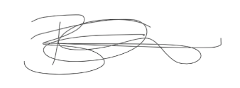
Course structure and approach
Attendance at sessions is mandatory. This includes webinars and face-to-face sessions.
During face-to-face sessions, participants are expected to wear professional dress.
During webinars, participants are expected to have cameras on and be able to use a microphone. The sessions are interactive, and use break-out rooms to discuss provocations, and thus engagement via camera and microphone is essential.
This is your space to learn, and we would ask that you put aside all other environmental distractions and priorities to engage fully in the sessions.
Your participation and engagement are pre-requisites to enable you and your colleagues to optimise the learning opportunities. This will mean that your preparation, using the asynchronous materials, in advance, is key, and that you are ready to respectfully share your perspectives on these. The programme will endeavour to enable you to question your own theories of action, so that you might enhance decision making in your own setting and others that you might encounter.
It is expected during the session for you to wear a red lanyard and not leave the lodge without being accompanied by TGAT staff.
You must have completed onboarding and have attended the first national seminar by 18th November 2024. Failure to do so will result in any secured DfE funding being revoked and may result in not being able to apply for further NPQ funding in the future.
We hope this serves as a useful introduction to your qualification. On the next page, you will find details of the schedule, including the dates of the various elements of the programme, some of which are local sessions and other are national events. TDT will be organising the national events and you should await further information from them regarding these elements.
We are really looking forward to working with you. If you have any questions, please do not hesitate to get in touch, using the following email address: tsh@tgacademy.org.uk
Billie Stewart
Operations and Strategic Lead

Slide 6


Programme Dates
Delivery Session Name | Delivery Mode | Date | Start Time | End Time
National Seminar 1 | Online | 4/11/2024 | 3:30 pm | 5:00 pm
Seminar 1 | Face to Face | 29/11/2024 | 10.00am | 12 noon
Seminar 2 | Online | 13/1/2025 | 3.30pm | 5.00pm
Face to Face Workshop 1 | Face to Face | 4/2/2025 | 12 noon | 4.00pm
National Seminar 2 | Online | 4/3/2025 | 3:30 pm | 5:00 pm
Seminar 3 | Online | 18/3/2025 | 3.30pm | 5.00pm
Seminar 4 | Online | 6/5/2025 | 3.30pm | 5.00pm
Face to Face Workshop 2 | Face to Face | 2/6/2025 | 12 noon | 4.00pm
National Seminar 3 | Online | 12/6/2025 | 3.30pm | 5:00 pm
Seminar 5 | Online | 30/6/2025 | 3.30pm | 5.00pm
Seminar 6 | Online | 9/9/2025 | 3.30pm | 5.00pm
Face to Face Workshop 3 | Face to Face | 22/9/2025 | 12.30pm | 4.30pm
The Face-to-Face sessions will be conducted at Tudor Grange Academy Solihull in The Lodge building
Prince Henry’s High School • Evesham • Worcestershire • WR11 4QH
Tel: 01386 765 588
Email:tsh@princehenrys.worcs.sch.uk
Dingle Lane • Solihull • West Midlands • B91 3PD
Tel: 0121 705 5100 • Fax: 0121 703 8226
Email: tsh@tgacademy.org.uk
@tudorgrangetsh

