Slide 1
Facilitation with Tudor Grange Teaching School Hub
Summer 2023
Notes:
30 minute briefing

Slide 2
Agenda
Welcome
Course Outline and Assessment
Event cycle
Expectations and Best Practice
Networking
Onboarding, Communication and TDT Training
Logistics
SLAs and Payment

Slide 3
Tudor Grange Facilitators
Experienced Teachers and Leaders
Knowledge of the ECF evidence base
Knowledge of the framework and the programme
Excellent facilitation skills
Engaging Communicators
Reliable, responsive, reflective
A CPD experience

Slide 4
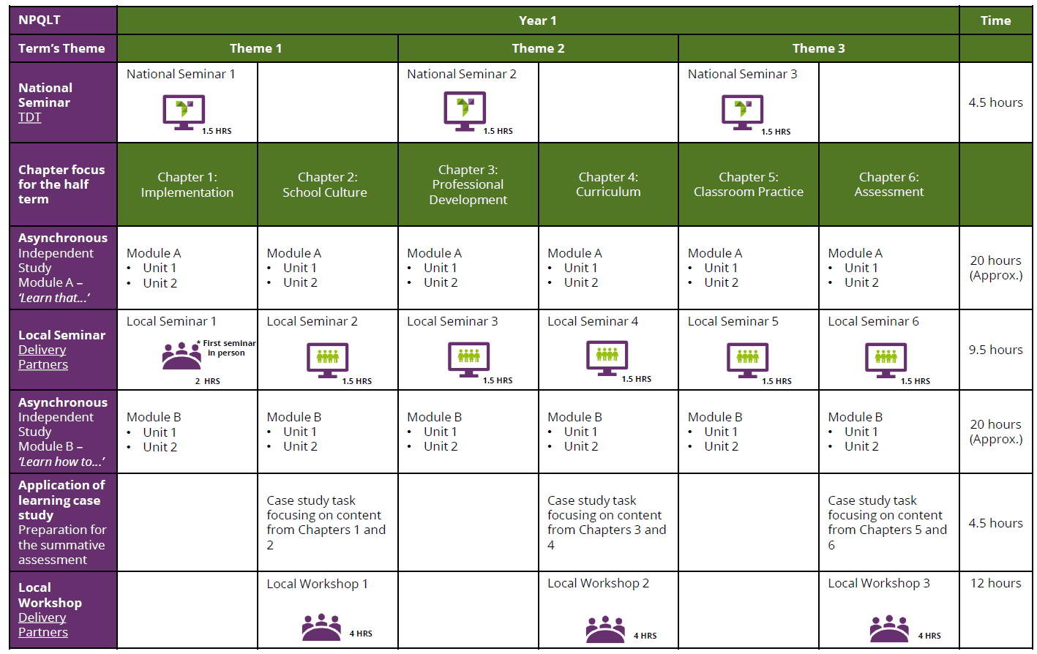
Cohorts start in Autumn and Spring
x2 online seminars per term
x1 face to face workshop per term
Asynchronous online learning
Discussion boards
Notes:
Leadership qualifications like this but over 18 months

Slide 5
Assessment
Assessments are a 1500-word response to a case study at the end of the course
Participants have 1 week to complete
Assessment window is two weeks immediately after
Half the number of the cohort
Not your own group
Comparative judgement
Further training by TDT
In the event of a failure, we offer a 1:1 with an experienced assessor and TDT offer a top-up session

Slide 6
Expression of Interest
Agree and sign SLA
FACILITATOR ONBOARDING
Discussion with NPQ Lead
Attend TSH onboarding welcome
Decide not to proceed
Decide to proceed
Register with TSH
Complete TDT Audit and Training
Notes:
SLAs not yet been distributed and signed

Slide 7
Tudor Grange TSH Communication
Termly bulletins
Website page
Reminders before events (week before)
Drop-in sessions weekly (link on bulletin)

Slide 8
TDT Facilitator Training
TDT Learn Platform
Facilitator Training

Slide 9
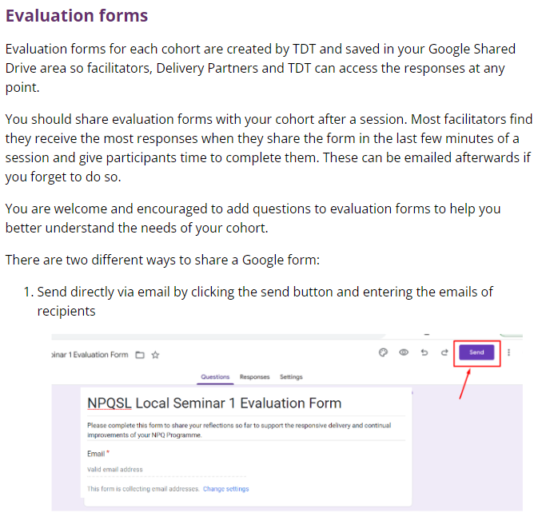
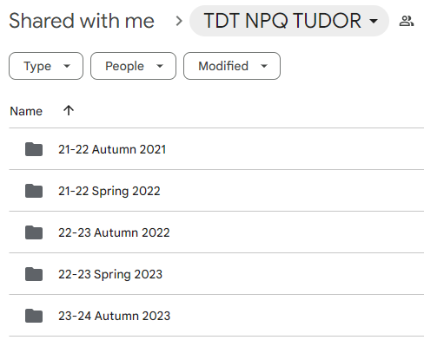
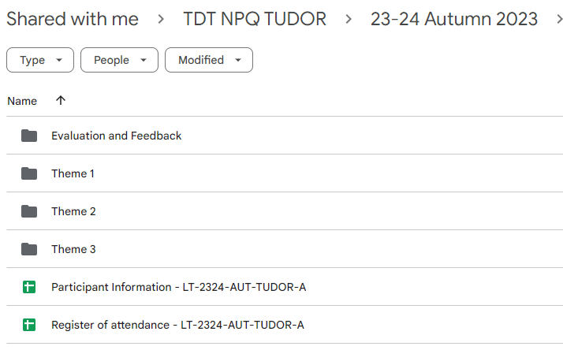
Logistics: Google Drive
Training on TDT Learn
Access:
Resources
Registers
Evaluation forms
Key dates

Slide 10
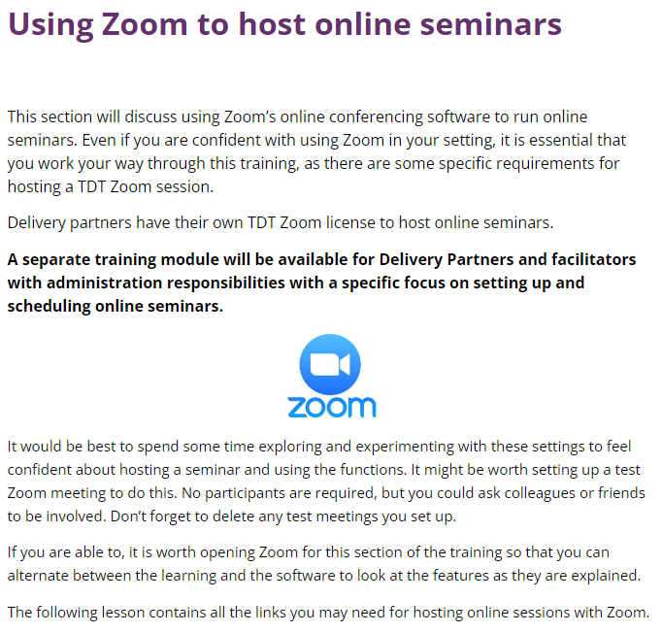
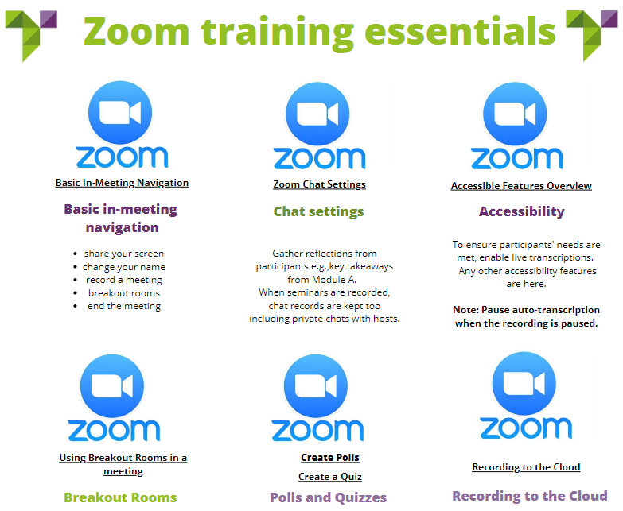
Logistics: Zoom
Training on TDT Learn
Supplementary document on website
Drop in sessions
Can organize specific zoom sessions to troubleshoot
Worth practicing!

Slide 11
Agree on Event details
Action feedback for next event
Complete TDT training
Self-reflection tool
FACILITATOR EVENT CYCLE
NO
YES
Personalised coaching conversation
Engage with catch-up materials
Liaise with co-facilitators
Finalise planning
Complete event and share resources
QA observation

Slide 12
Expectations
(Guidance on TDT Learn Facilitator Training)
Online sessions:
Practice before the session!
Log in using the TDT account
Log in a little early and check the mic, speakers and powerpoint
some find logging in using the participant link on a phone useful here!
Set expectations:
Names – no school names!
Cameras on
Consider ways to increase engagement
Jamboard etc
Face to face sessions:
Arrive in time to get set up
Ensure safeguarding and fire policies are shared at the start of the session
Do not go anywhere unaccompanied unless you work at that school!
Greet participants warmly
Make an effort to learn names
Stick to timings, but priorities discussions where necessary

Slide 13
Best Practice
Acknowledging of school policy and limitations
Set up of the room and groupings and networking
Investing in relationships
Role models, ambassadors and advocates for teaching
Honest but prepared
Model high expectations
What have you done that works?
Tips and tricks for online delivery?
What is expert facilitation?

Slide 14
Best Practice
Emphasise the message ‘we are all teachers of SEND’.
Ensure participants engage with the NPQ framework statements by creating an activity out of them.
Be expert in the session content and its context to enable you to pose challenges. Play Devil’s advocate.
Make the participants work hard.
Intentional Monitoring
Cold calling
High expectations
Show empathy and be realistic/authentic
Experience vs. research

Slide 15
SLAs and Payments
SLAs will be shared after training is complete
Comprehensive summary of responsibilities
Payment information outlined

Slide 16
Questions

